Slide 1
Instagram Performance Analytics for Sugar Cosmetics

Slide 2
Overview KPIs
Insights:
📸 Total Posts: 50,000
❤️ Total Likes: 147.7M
💬 Total Comments: 18.4M
👀 Total Reach: 987.4M
🔁 Avg. Engagement Rate: 2%
Interpretation:
→ Strong reach and engagement, but opportunities exist to convert views into interactions.

Slide 3
Monthly Posting Trend
Task
Analyze how frequently the brand posts content over time. Create a line chart that displays the number of posts per month.
Observation:
Posting frequency is fairly consistent across months.
Peak posting months: dec.
Insight:
→ Consistent posting helps maintain audience visibility; spikes indicate campaign launches or seasonal promotions.

Slide 4
Top 10 Posts by Likes
Task
Identify and visualize the top 10 posts that received the most likes.
Insight:
Reels and Video formats dominate the highest likes.
Posts with influencers or trending audio performed best.

Slide 5
Top 10 Posts by Engagement Rate
Task
Similar to the previous sheet, but now sort posts based on engagement rate to identify high-performing content beyond just likes.
Insight:
Even simple posts with limited reach performed well due to high interaction rates.

Slide 6
Post Type Performance Comparison
Task
Compare the performance of different post types (e.g., Image, Video, Carousel). Show average likes, comments, saves for each type.
Findings:
Reels: Highest average engagement
Images: Good reach but lower interaction
Stories: Moderate engagement; best for polls & updates
Insight:
→ A balanced content mix with more stories ensures reach and engagement.

Slide 7
Day of Week Analysis
Task
Analyze how posts perform on different days of the week. Show average engagement by weekday.
Insight:
Tuesday, friday

Slide 8
Engagement Funnel
Task
Visualize how users interact with content using a funnel. Sequence: Impressions → Reach → Likes → Comments → Shares → Saves.
Insight:
Need more engaging CTAs (e.g., “Tag a friend”, “Save for later”).

Slide 9
Hashtag Analysis
Task
Analyze how various hashtags perform. Visualize average engagement rate or reach across different groups.
Findings:
Popular hashtags: #SugarCosmetics,#BoldLooks, #VeganBeauty, #BeautyTips
Branded + trendy hashtags increased visibility.
Insight:
→ Smart hashtag strategy can expand organic reach.

Slide 10
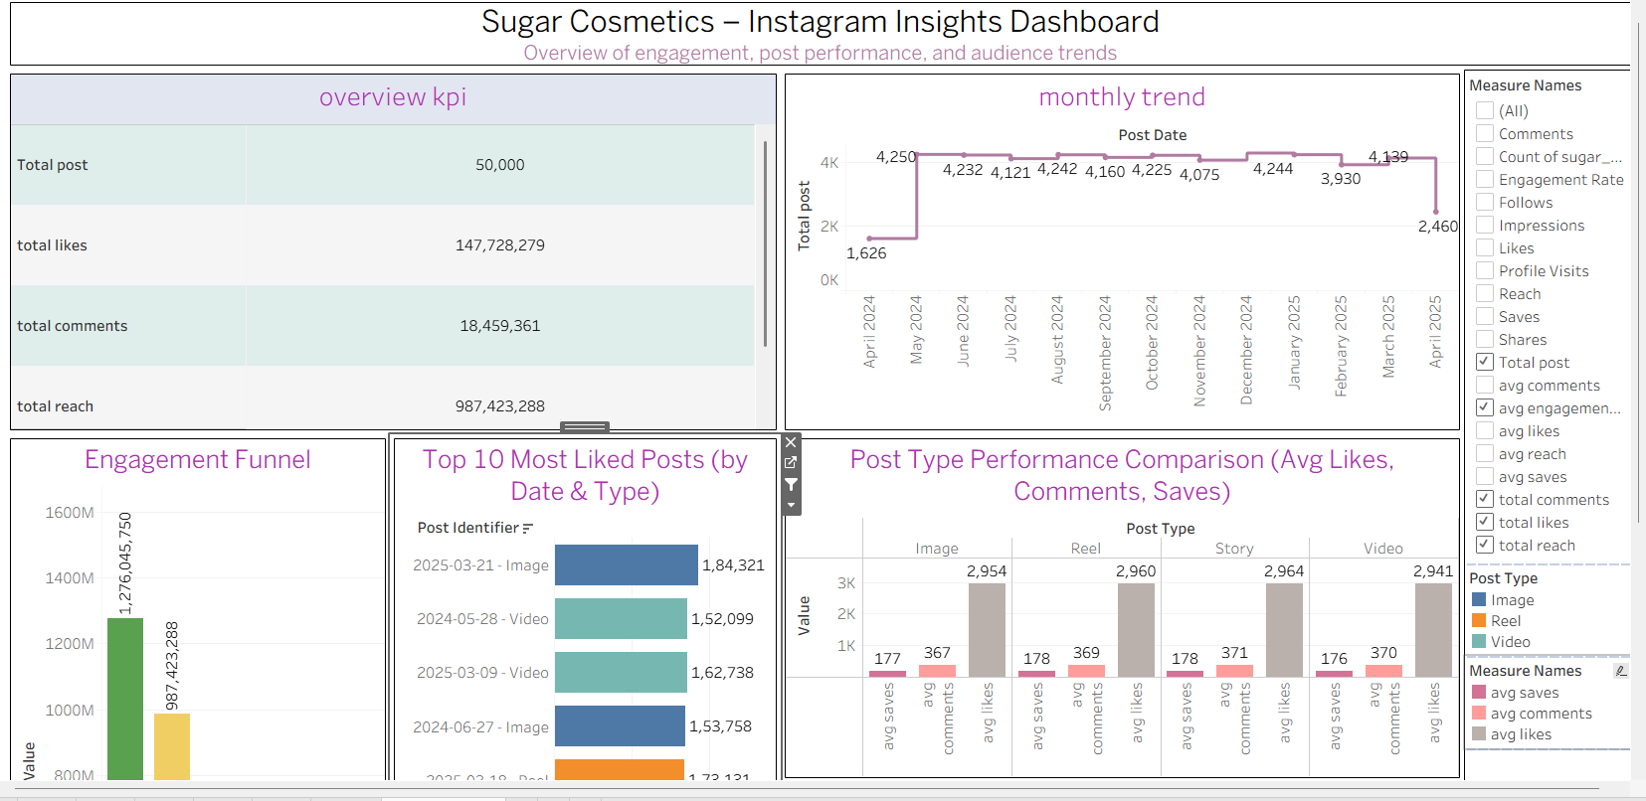
Dashboard Overview
Highlight:
→ Interactive visual report for marketing decisions.

Slide 11
Strategic Recommendations
Task
Provide data-driven insights to refine and support social media strategy.
Key Takeaways:
✅ Focus on Reels & influencer content
✅ Post 3–5 times per week during peak engagement days
✅ Improve engagement funnel via captions & CTAs
✅ Mix branded and trending hashtags
✅ Launch seasonal campaigns (festive looks, tutorials, user challenges)

Slide 12
Conclusion
Overall Summary:
Sugar Cosmetics has strong audience reach and potential for higher engagement through video-first, community-driven content.

Slide 13
Thank you

